Slide 1

CALLING ALL
Autonomous Sensor Experts
Now that you are an autonomous robot sensor expert, people will come to you to get help with their robots whenever the sensors malfunction.
Read the scenarios on the following slides.
Diagnose the robot, suggest which sensor needs repairs and why.

Slide 2
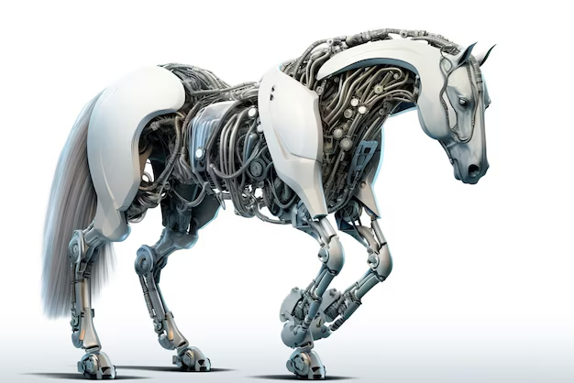
Diagnose and Repair Scenario 1: Robot Horse
A company creates robot horses for horse races. The horses are only supposed to let a person ride if they recognize their owners name on the rider’s helmet. For some reason, the horses have been allowing the wrong person to ride. The horse only has 3 sensors: Camera, Radar, and GPS.
Which sensor do you think is malfunctioning?
…
How did you figure out which sensor is malfunctioning?
…
Notes:
Options:
Read this out and give the students think time. Think, Pair, Share
You can have the students do this individually and then go over it large group.

Slide 3
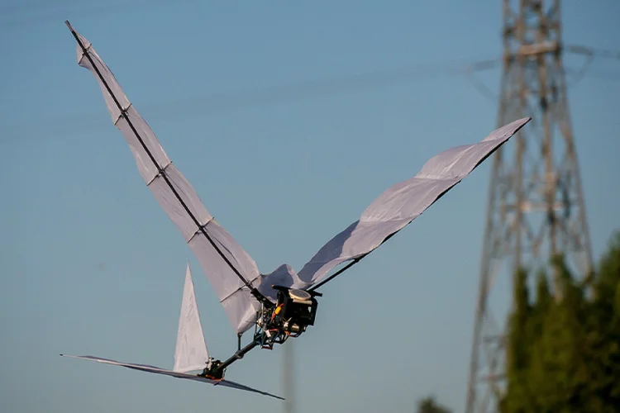
Diagnose and Repair Scenario 2: Robot Bird
A company specializes in making self-flying drones shaped like birds. Recently, their drones have been crashing into small hummingbirds while flying. The drone only has 3 sensors: GPS, Lidar, and Radar.
Which sensor do you think is malfunctioning?
…
How did you figure out which sensor is malfunctioning?
…

Slide 4
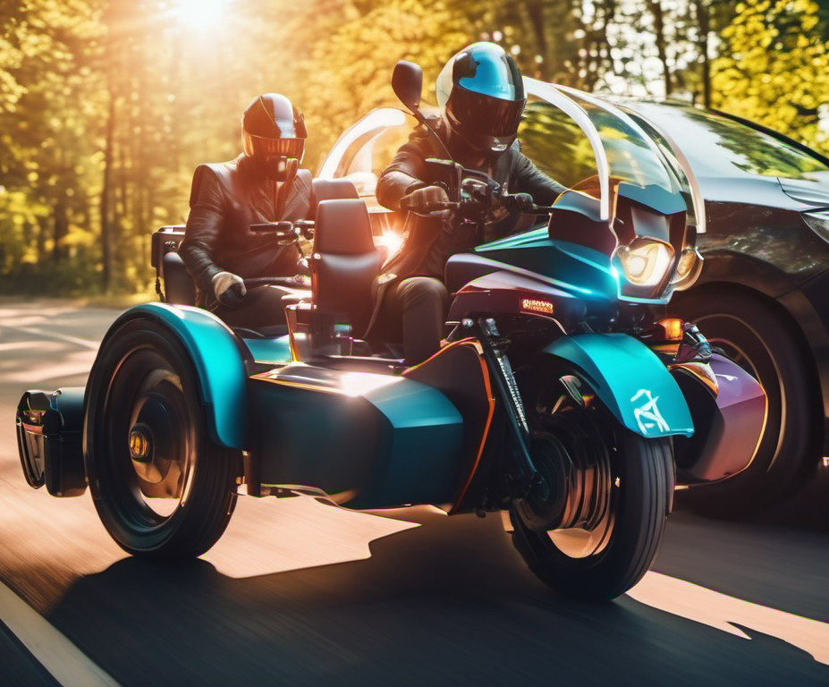
Diagnose and Repair Scenario 3: Treasure Hunting Trike
You are on a treasure hunt. Each group is riding on an autonomous trike. You program location 1 into the trike and find yourself at a lake but are supposed to be at the museum. The trike only has 3 sensors: GPS, Lidar, and Radar.
Which sensor do you think is malfunctioning?
…
How did you figure out which sensor is malfunctioning?
…

Slide 5

NICE JOB!
Now that you have helped people repair their autonomous robots, you have become popular in the robot community. People want to consult you to make their dream robots a reality. Let’s do it!

Slide 6
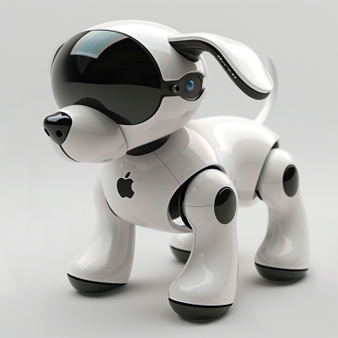
Design Scenario 1: iDoggo
Apple has contacted you to help create their iDoggo robot pet. They want the it to be a companion to people while they are at home. It does not need to go outside.
Created by Midjourney prompt “Ddoggo a robot dog home companion made by Apple Computer”

Slide 7
Design Scenario 1: iDoggo
List 3 decisions iDoggo needs to know how to make.
  …
  …
  …
Which sensors will iDoggo need to function properly?
  …
Why are those the best sensors for iDoggo?
  …

Slide 8
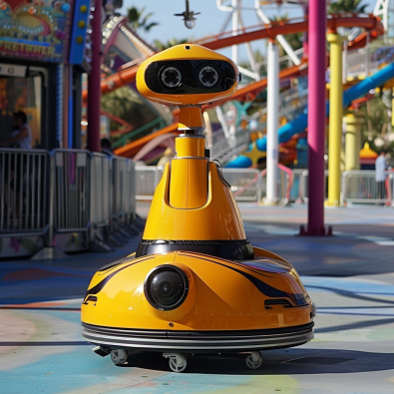
Design Scenario 2: Coaster Cleanser
Six Flags has called you to help build their amusement park custodial robot called the Shine Sentry. This robot needs to be able to clean up the amusement park everyday while the customers are present, even in bad weather.
Created by Midjourney prompt “a robot designed to clean amusement parks”

Slide 9
Design Scenario 2: Coaster Cleanser
List 3 decisions Coaster Cleanser needs to know how to make.
  …
  …
  …
Which sensors will Coaster Cleanser need to function properly?
  …
Why are those the best sensors for Coaster Cleanser?
  …

